Slide 1
APIs – Theory and Practical Implementation

Slide 2
Lecture Overview
In this module, we'll explore the world of Application Programming Interfaces (APIs), understand their significance in modern software development, and learn how to design and implement them effectively. We'll dive into different types of APIs, with a focus on REST and GraphQL, and discuss best practices for API design. In the practical segment, we'll implement APIs in Python using FastAPI and learn how to call them using Postman.

Slide 3
Learning Objectives
By the end of this lecture, students will be able to:
Understand the Fundamental Concepts of APIs
Differentiate Between Types of APIs
Apply Best Practices in API Design
Develop APIs Using Python and FastAPI
Call APIs Using Postman

Slide 4
What is an API?

Slide 5
What is an API?
An Application Programming Interface (API) is a set of rules and protocols that allows different software applications to communicate with each other. APIs define the methods and data formats that applications use to request and exchange data.

Slide 6
Fundamentals of APIs
Interoperability
APIs enable different systems and applications to work together seamlessly.
Reusability
Developers can leverage existing APIs to add functionality without building from scratch.
Scalability
APIs allow services to scale by distributing workloads across different systems.
Innovation
By exposing services through APIs, organizations encourage developers to build new applications on top of their platforms.

Slide 7
Examples

Slide 8
Examples

Slide 9
Examples

Slide 10
Types of APIs
REST API
GraphQL
Notes:
There are many others but we wont look into them

Slide 11
REST API
REST api or RESTful api stands for Representational State Transfer Application Programming Interface.

Slide 12
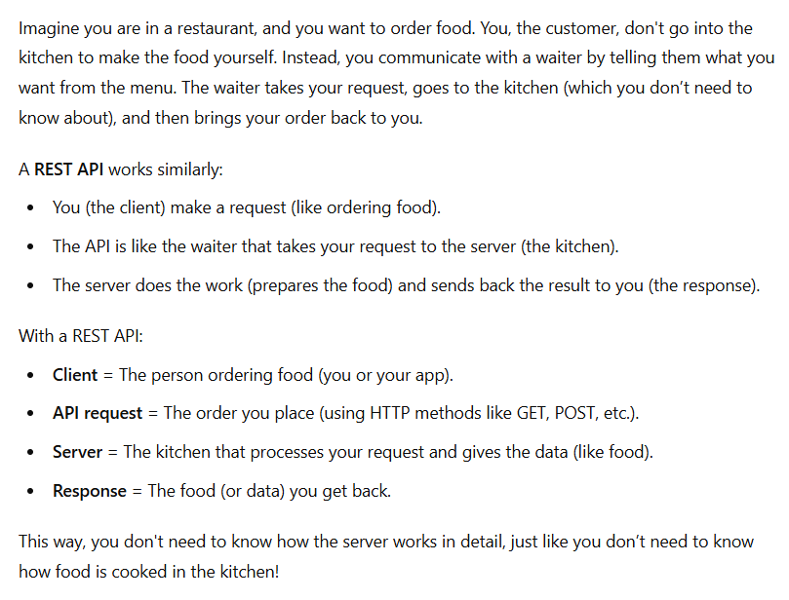

Slide 13
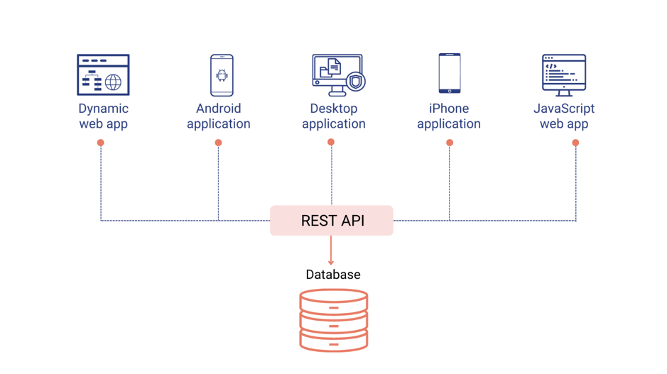

Slide 14
GraphQL
GraphQL is a query language for APIs that allows clients to request exactly the data they need, and nothing more.

Slide 15
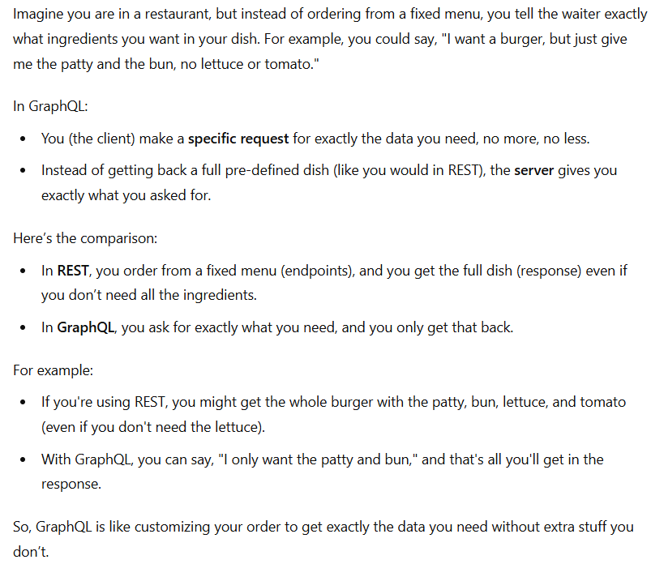

Slide 16
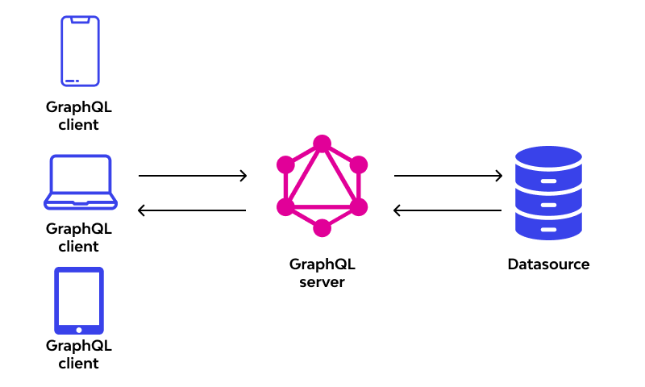

Slide 17
Response of an API
An API response is the data or result returned by the server after it processes a request from the client. Responses usually include information about the outcome of the request, such as success or failure, along with any requested data.

Slide 18
Components of a Response
Status Code
Headers
Body (Payload)

Slide 19
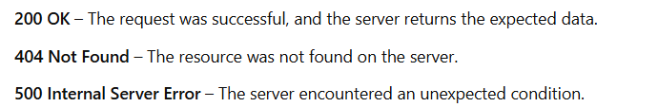
Status Code
These help indicate the status of the request either success or error

Slide 20
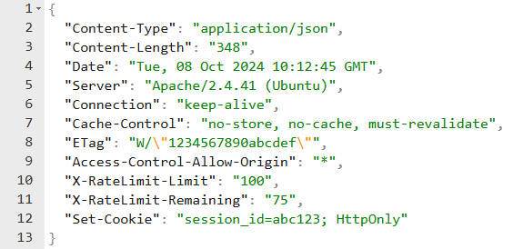
Headers
Metadata about the response, such as content type or length
Notes:
Metadata

Slide 21
Body (Payload)
Contains the actual data being returned by the server (if applicable). This can be in formats like JSON, XML, or HTML.

Slide 22
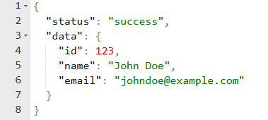
JSON (JavaScript Object Notation)
JSON is a lightweight data format that is easy for both humans and machines to read and write. It is the most common format used in modern APIs.

Slide 23
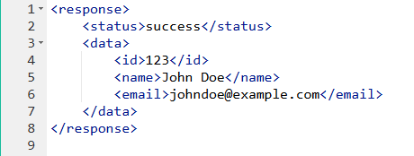
XML (eXtensible Markup Language)
XML is a markup language that defines a set of rules for encoding documents in a format that is both human-readable and machine-readable. It is commonly used in older APIs and in enterprise environments.

Slide 24
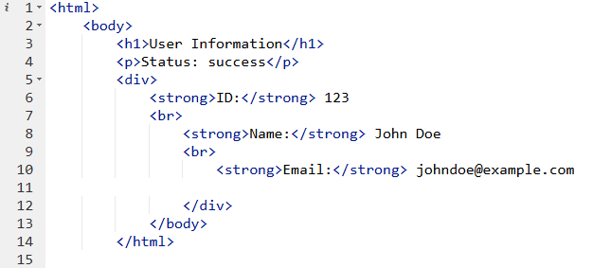
HTML (HyperText Markup Language)
HTML is primarily used to structure content on the web but can also be used as an API response format. It's less common for data exchange compared to JSON or XML but might be used in certain cases, such as returning error messages.

Slide 25
Let’s build an API

